Slide 1



Amazon Web Services 101
AWS Introduction
Why are enterprises choosing AWS?
What are enterprises using AWS for?
How are enterprise getting started with AWS?

Slide 2
AWS Provides Broad and Deep Services to Support Any Cloud Workload
Deployment & Administration
Application Services
Compute
Storage
Database
Networking
AWS Global Infrastructure

Slide 3

Lower Costs with AWS Up-Front and Increase Savings as Your Usage Grows
Why are enterprises choosing AWS?
1
2
3
4
Replace up-front capital expense with low variable cost
Economies of scale have allowed us to consistently lower costs
Pricing model choice to support variable & stable workloads
Save more money as you grow bigger
“Average of 400 servers replaced per customer”
44 Price Reductions
On-demand
Tiered Pricing
Reserved
Volume Discounts
Spot

Slide 4

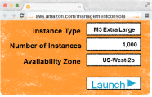
Enterprises Can’t Afford to be Slow
Old World:
Infrastructure in Weeks
AWS:
Infrastructure in Minutes
Add New Dev Environment
Add New Prod Environment
Add New Environment in Japan
Add 1,000 Servers
Remove 1,000 servers
Deploy 2 PB Data warehouse
Shut down 2 PB Data warehouse
Everything changes with this kind of agility
Notes:
no script

Slide 5


The Good News is that Cloud isn’t an ‘All or Nothing’ Choice
On-Premises Resources
Cloud Resources
Integration
Corporate Data Centers

Slide 6

Integrating AWS with Your Existing On-Premises Infrastructure
Active Directory
Network Configuration
Encryption
Backup Appliances
Your On-Premises
Apps
Users & Access Rules (IAM)
Your Private Network (VPC)
Encryption (S3, RDS, HSM)
Backups (Storage Gateway)
Your Cloud Apps
Corporate Data Centers
AWS Direct Connect
Notes:
And these are some of the key products that support this vision of hybrid cloud

Slide 7
AWS Introduction
Why are enterprises choosing AWS?
What are enterprises using AWS for?
How are enterprise getting started with AWS?

Slide 8

Enterprises Use Cases on AWS
Enterprise Apps and Dev./Test
Big Data and
HPC
Storage, Backup and Archival
Web, Mobile, and Social Apps
Disaster Recovery
Virtual Desktops

Slide 9
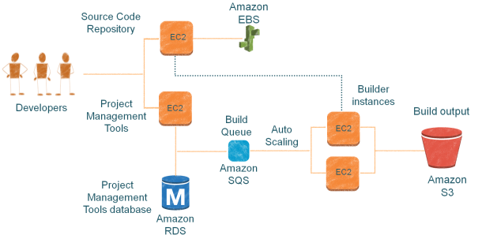
Development and Test Environments
AWS Dev./Test Scenarios
On-demand Dev. environments
On-Demand Builds
Automated Test environments
Load Testing

Slide 10
Big Data
Generation
Lower cost, higher throughput
Collection & storage
Close the gap.
Highly constrained
Analytics & computation
Collaboration & sharing
Technologies and techniques for working productively with data, at any scale
Elastic and highly scalable + No upfront CapEx + Only pay for what you use + Available on-demand = Remove constraints

Slide 11





Big Data
Amazon EMR (Elastic MapReduce)
Amazon Redshift
AWS Data Pipeline
Managed Hadoop
Service
Easily launch, customize, and resize your managed Hadoop cluster
Petabyte-scale data
warehouse service
More data among AWS
Services and on-premises data sources
Amazon Kinesis - Fully-managed service for real time processing of streaming data, at any scale.
Plug and play with a simple, pre-built client library
Deploy Amazon Kinesis-enabled applications to Amazon EC2
Integrates with Amazon Redshift, Amazon DynamoDB, Amazon EMR, and Amazon S3

Slide 12
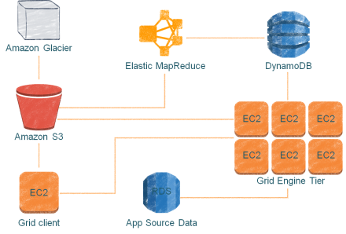
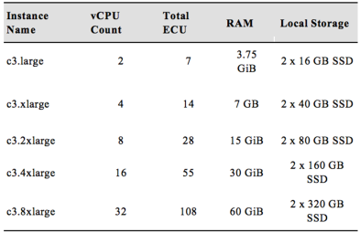
High Performance Computing (HPC)
C3 instances
Improved Network Performance
SSD based Platform

Slide 13






Storage, Backup, and Archival
On-premises Data Center
AWS Storage Gateway
Corporate File Sharing & seamless backup of enterprise data to Amazon S3
Block
File
Archive
Backup
Disaster Recovery
Amazon Elastic Block Store
Persistent Block Storage for EC2
Gateway Appliance/ AWS Storage Gateway
Amazon S3
Redundant, High-Scale Object Store
AWS Cloud
Amazon Glacier
Low-cost Archive Storage in the Cloud
Amazon EBS
Amazon S3
Amazon Glacier

Slide 14
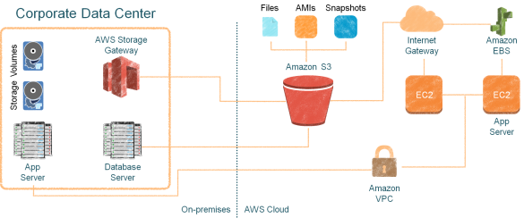





Disaster Recovery
AWS DR Scenarios Backup and Restore
Pilot Light for Simple Recovery into AWS
Warm Standby Solution
Multi-site Solution
Amazon RDS – Cross Region Read Replicas
Improved disaster recovery operations.
Readable copies for cross-region applications.
Easy migration between regions

Slide 15
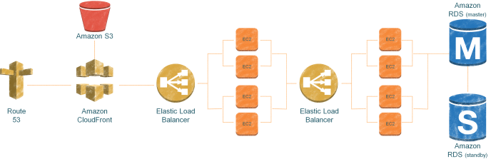
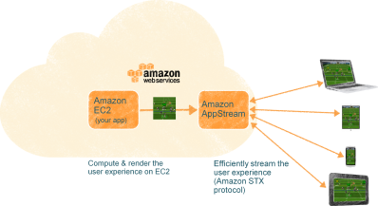
Web, Mobile, and Social Apps
Amazon AppStream
HD Video Quality Application Streaming
Captures user input to send back to the cloud. Responsive and consistent experience across devices

Slide 16




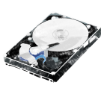
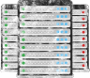




Amazon WorkSpaces
Virtual Desktops - Half the Price of On-Premises VDI
No hardware or virtualization software
Access through browser or tablet device
Monthly pricing—no long-term commitments
License software from us or bring your own licenses
Easy integration with MS Active Directory
No Server Hardware
No Storage Infrastructure
No VDI Software
No VDI Administration
X
X
X
X
Notes:
AppStream allows you to easily deliver low-cost virtual desktops that are secure, centrally managed and connected to your internal systems

Slide 17
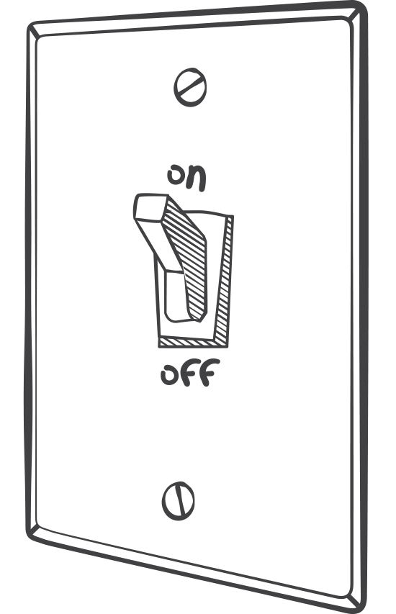
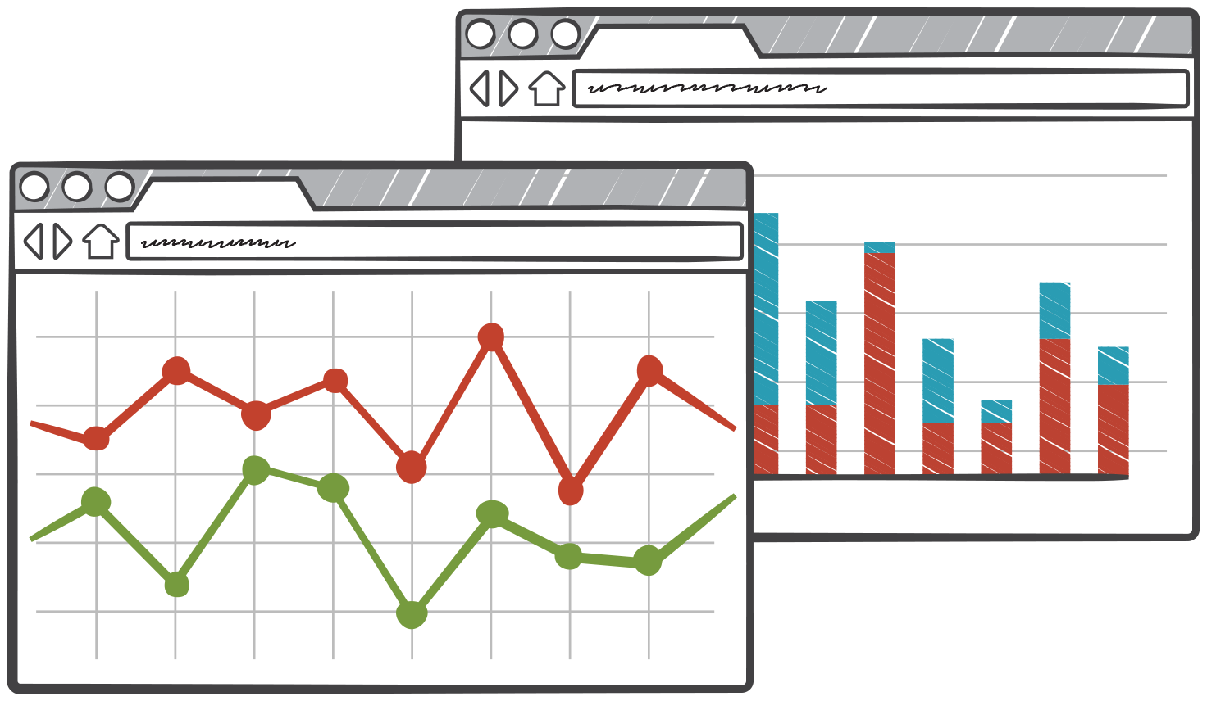

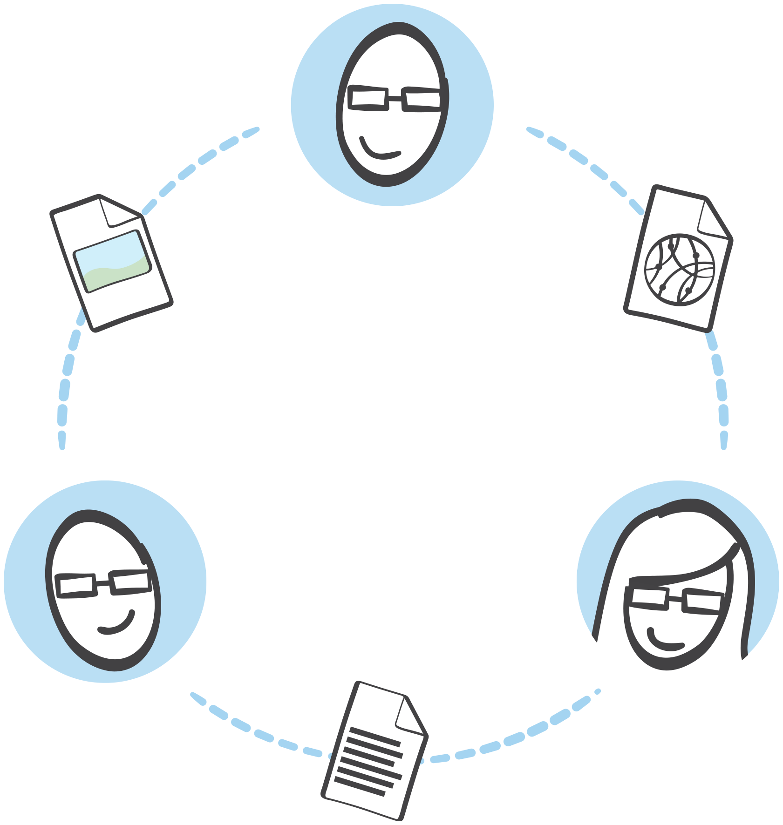

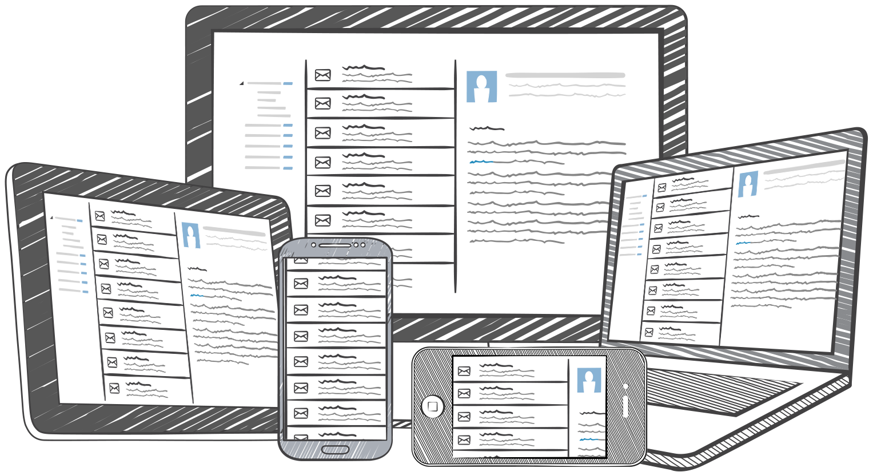

Today’s “Cloud Native” Applications
Deployed and managed, automatically
Cost aware
Globally distributed
Composed and orchestrated
Encrypted,
end to end
Content follows
you across devices

Slide 18
Sync state and data across devices, offline access, customer identity and login
Continual improvement based on customer usage
Building feature-rich, engaging apps is “increasingly reliant” on “back end” services
Safeguard customer data and credentials, Interact with broad set of AWS services
Notes:
Intro
Marco Argenti
VP,
AWS Mobile

Slide 19



Overcome the Challenge of Multiple Devices
Amazon Cognito
Fully managed user identity and data synchronization service
Manage unique identities & support multiple login providers
Seamlessly sync across devices & work offline via local data store
Safeguard AWS credentials
Identity
Synchronization
Security
+
+
Notes:
Amazon Cognito is a fully managed user identity and synchronization service, which has three components: identity, synchronization and a robust set of security features. These three components allow you to sync user preferences, resume game state across devices, securely access other AWS services from your mobile app, and offer that important anonymous guest access.

Slide 20
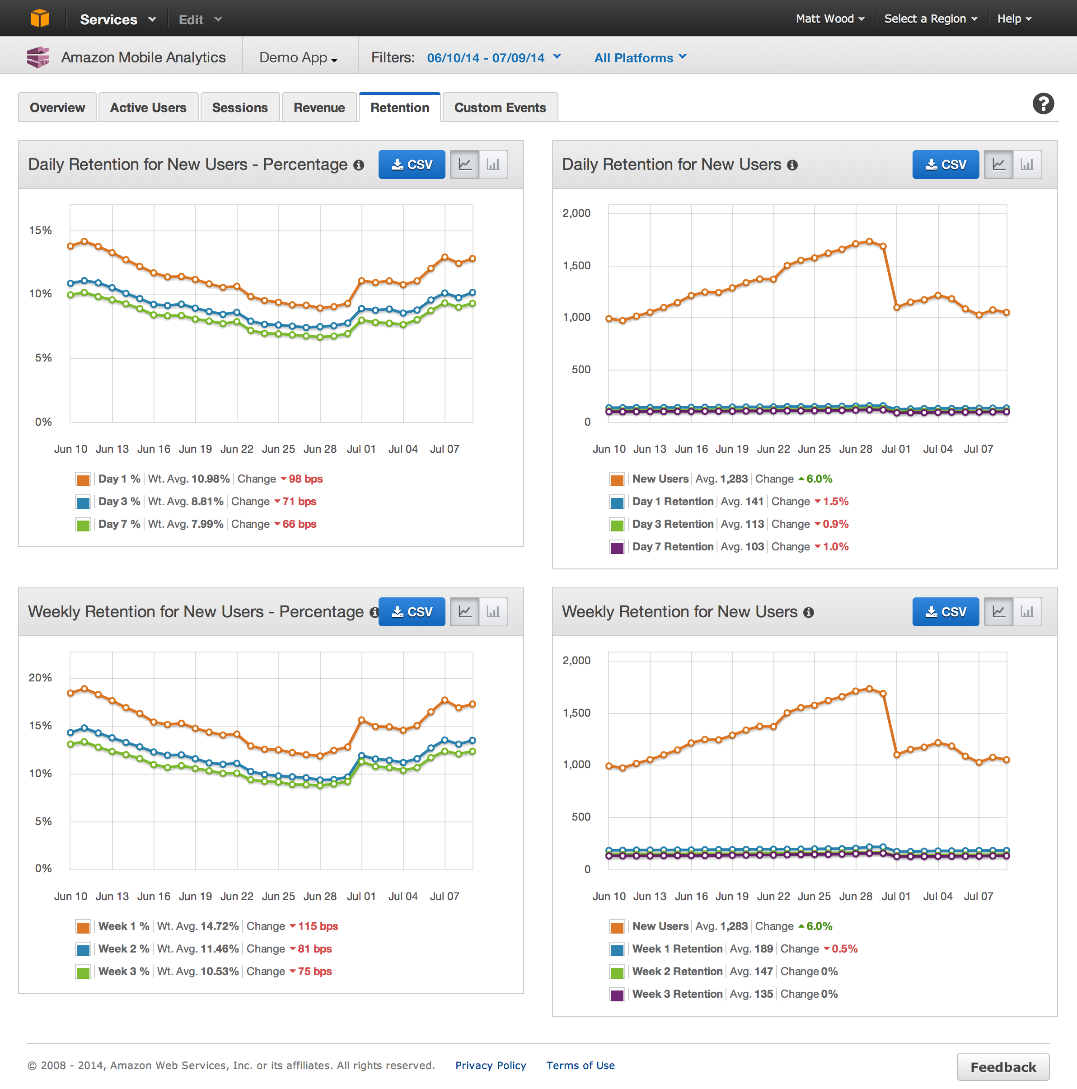
Fast, Reliable, User Engagement Metrics
Amazon Mobile Analytics
Fast: get your data within an hour
Automatic MAU, DAU, session and retention reports
Design and track custom app events
Data is not mined or sold by Amazon
Notes:
allows you to stay up to speed with how your own customers are using your app, with data available with an hour. It includes automatic monthly active user and daily active user metrics, along with session and retention reports. You can also design and track custom app events to extend you metrics in a way which makes most sense for your application. And finally, your retain ownership over your data, which is not mined or sold by Amazon.

Slide 21


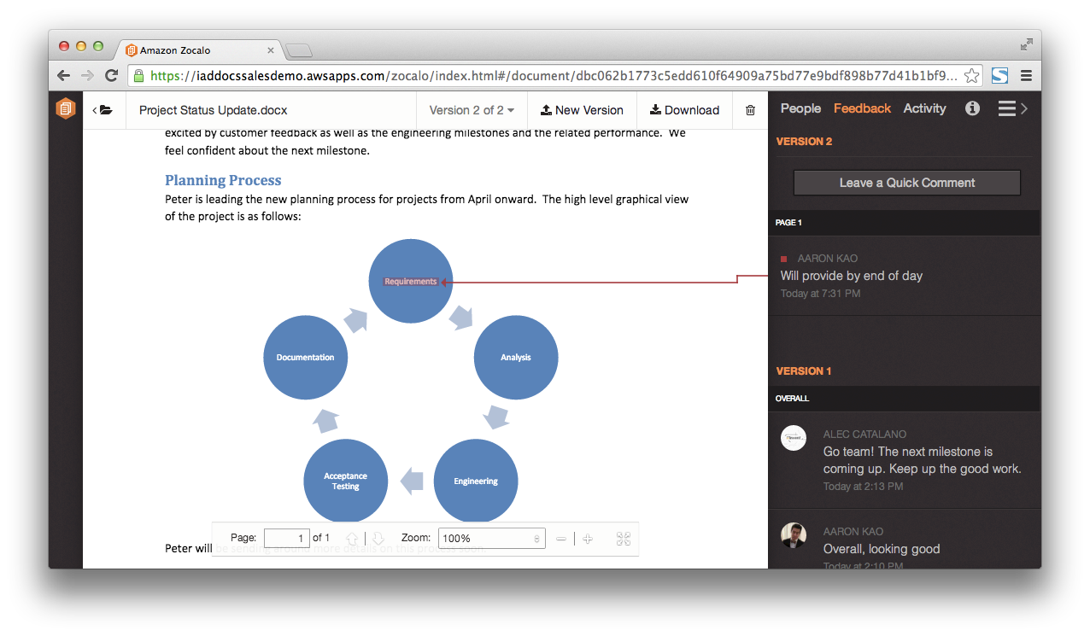





Document Sharing and Collaboration – The Next Enterprise IT Problem AWS is Solving
Amazon Zocalo
Fully managed, secure document storage and sharing
Simple document feedback
Access from any device
Secure and reliable
Integrate your corporate directory
Integrate your
corporate directory
Easy sharing
Simple document
feedback
Access from
any device
Secure
Low cost

Slide 22
AWS Introduction
Why are enterprises choosing AWS?
What are enterprises using AWS for?
How are enterprise getting started with AWS?

Slide 23



Strategy 1: Cloud for Development & Test Environments
SAP
Oracle Enterprise Applications
SAP
Reduced deployment time from weeks to days
Reduced test environment costs
70% reduction in operational costs
Notes:
Oracle = Tokyo Stock Exchange
The Tokyo Stock Exchange is using Amazon EC2 and Amazon VPC in the AWS Tokyo Region as a cost effective test environment to run Oracle's Enterprise Manager 11g IT management package for verification and service monitoring.
SAP = Lionsgate
Lionsgate, a $2 billion global entertainment corporation, currently uses AWS for production Microsoft SharePoint and SAP development and test resulting in significant cost savings and reduced application deployment time from weeks to days.
SAP = Galata Chemicals
Galata Chemicals, an additives producer based in Connecticut, wanted to lower IT costs while maintaining a disaster recovery solution for their SAP ERP system. Galata worked with Protera Technologies to move Galata’s disaster recovery solution to AWS, saving time and reducing operational costs by approximately 70% when compared to an on-premises solution.

Slide 24













Strategy 2: Build New Apps in the Cloud
Faster to build
Easier to manage
Less expensive to run
Distributed architectures for high availability
Financial record archiving
Global deals engine
Product Prototyping & Design
Hotel booking engine
Video streaming
App streaming
Firmware upgrades
Clinical trial simulations
Global web properties
Audience management & creative design
Biological data research
SIM card credit
News distribution
Mobile games
Notes:
Oracle = Tokyo Stock Exchange
The Tokyo Stock Exchange is using Amazon EC2 and Amazon VPC in the AWS Tokyo Region as a cost effective test environment to run Oracle's Enterprise Manager 11g IT management package for verification and service monitoring.
SAP = Lionsgate
Lionsgate, a $2 billion global entertainment corporation, currently uses AWS for production Microsoft SharePoint and SAP development and test resulting in significant cost savings and reduced application deployment time from weeks to days.
SAP = Galata Chemicals
Galata Chemicals, an additives producer based in Connecticut, wanted to lower IT costs while maintaining a disaster recovery solution for their SAP ERP system. Galata worked with Protera Technologies to move Galata’s disaster recovery solution to AWS, saving time and reducing operational costs by approximately 70% when compared to an on-premises solution.

Slide 25




Strategy 3: Use Cloud to Make On-Premises Apps Better
App 1
Elastic Map Reduce
App 2
Analytics
App 3
Amazon Redshift
…
AWS Storage Gateway
Backup
Corporate Data Centers
Amazon S3
App N

Slide 26

Strategy 3: Use Cloud to Make On-Premises Apps Better
Big Data Analytics
Big Data Analytics
Export operational data to AWS for analytics processing
50% cost reduction with 2x faster queries using Amazon Redshift

Slide 27


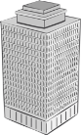
Strategy 4: Cloud Apps that Integrate with On-Premises Apps
AWS serves application content & data
Hybrid App
Integration to Samsung data centers for financial transactions
On-Premises Data Centers

Slide 28



Strategy 5: Migrate Existing Apps to the Cloud
1/3 of servers migrated to AWS
Migrated 500 web properties in 5 months
Migrated clinical trials simulations platform
App
Saved £1.5 Million
New product web sites live in 2 days vs. 2 weeks
Simulations in 1.2hrs vs. 60hrs
64% reduction in costs
On-Premises Data Centers

Slide 29


Strategy 6: All In
100s of applications supporting 33M+ global members
10,000s of EC2 instances in multiple regions & zones
At peak consumes 1/3 of US Internet bandwidth

Slide 30

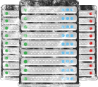




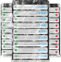

Spotlight Customer: DowJones News Intl
From over 40 data centers down to 6
Planning to migrate 3000 Apps by January 2015; Saving 100M over 3 Years
Evaluate infrastructure
Make business case
Move to the cloud
VS
Notes:
no script

